Slide 1



AKANKSHA SHARMA
COVID-19 Vaccination Trends and Effectiveness

Slide 2

This project uses SQL to analyze global COVID-19 vaccination data. We explored vaccination trends, identified top-performing countries, and examined vaccine usage by different manufacturers. Key metrics like time to reach 1 million doses and dominant vaccine brands were derived using advanced SQL queries.
PROJECT INTRODUCTION
AKANKSHA SHARMA

Slide 3

AKANKSHA SHARMA
BASIC QUESTIONS
Which country administered the highest number of total vaccinations?
List all distinct vaccines used globally.
What is the average daily vaccination per country?
Which countries had zero or null vaccinations on any day?
Which country has the latest vaccination record in the dataset?

Slide 4
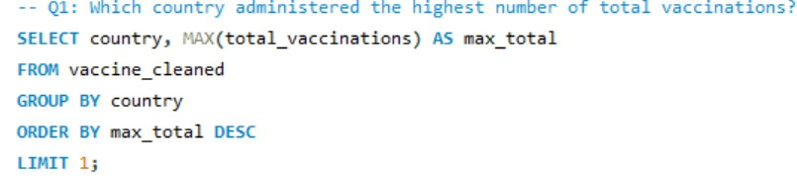
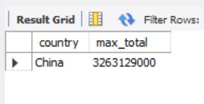
Q1:Which country administered the highest number of total vaccinations?

Slide 5
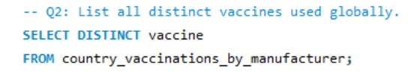
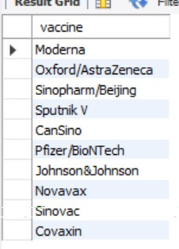
Q2: List all distinct vaccines used globally.

Slide 6
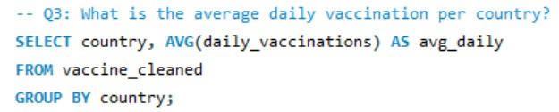
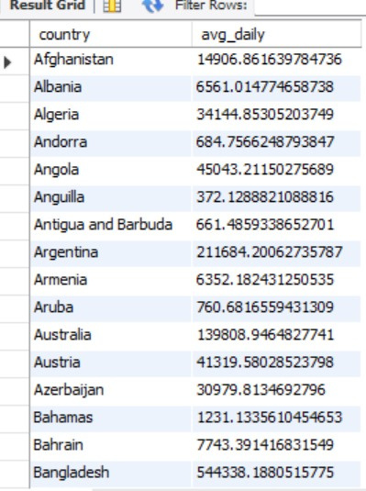
Q3: What is the average daily vaccination per country?

Slide 7
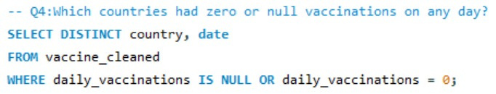
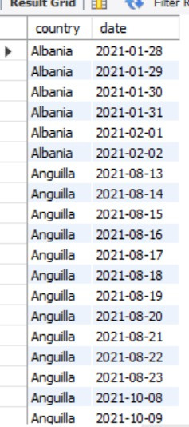
Q4:Which countries had zero or null vaccinations on any day?

Slide 8
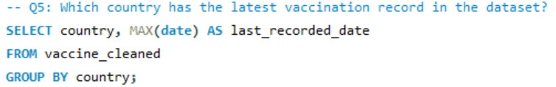
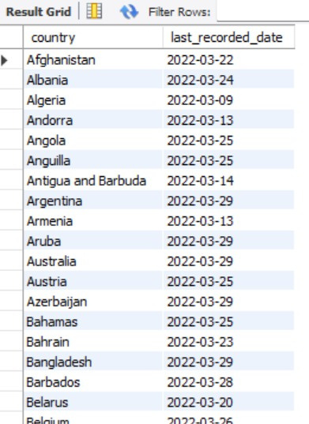
Q5:Which country has the latest vaccination record in the dataset?

Slide 9
AKANKSHA SHARMA
INTERMEDIATE QUESTIONS
Which country had the most consistent rollout (lowest std deviation)?
Which country used the highest number of vaccine manufacturers?
Which are the top 3 most-used vaccines worldwide?
Which country used the highest number of different vaccine manufacturers?

Slide 10
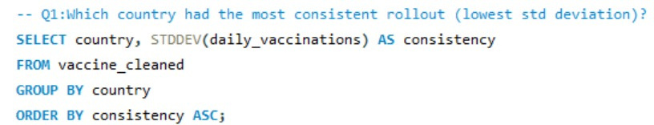
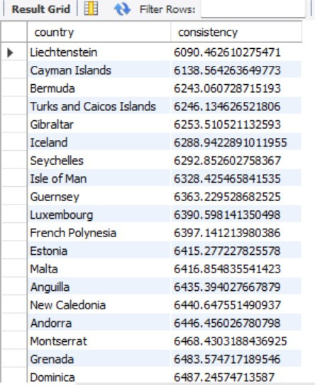
Q1: Which country had the most consistent rollout (lowest std deviation)?

Slide 11
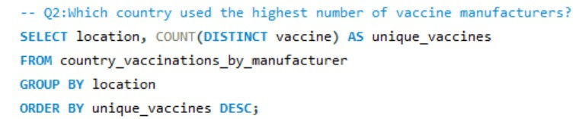
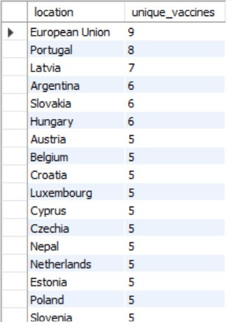
Q2: Which country used the highest number of vaccine manufacturers?

Slide 12
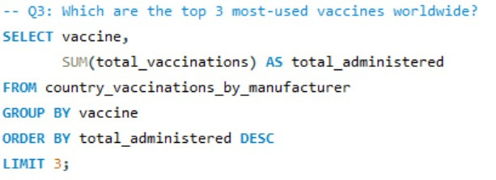
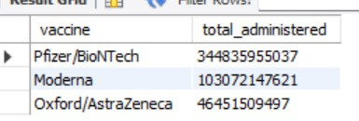
Q3: Which are the top 3 most-used vaccines worldwide?

Slide 13
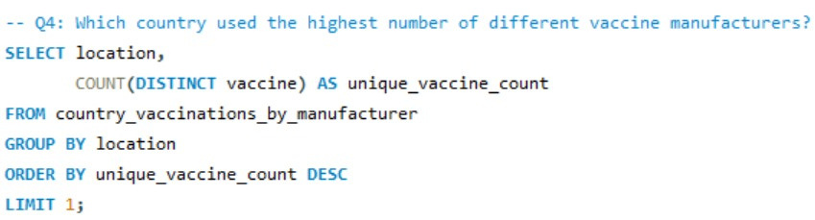

Q4: Which country used the highest number of different vaccine manufacturers?

Slide 14

AKANKSHA SHARMA
HARD QUESTIONS
Countries where one vaccine contributed >70% of total vaccinations.
Top vaccine in first 60 days for each country.
Countries with 80%+ vaccinations from one manufacturer

Slide 15
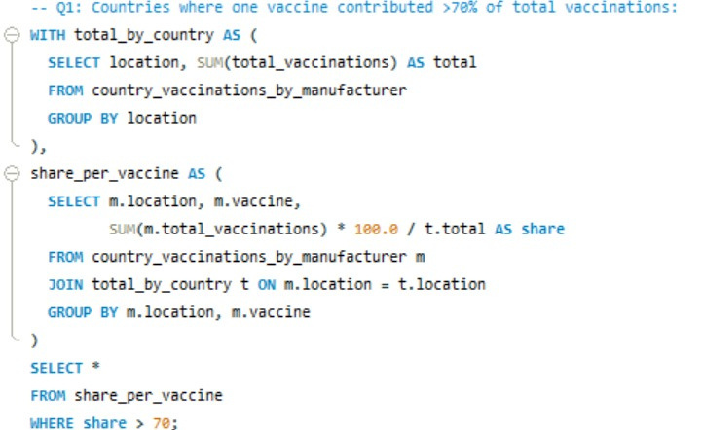
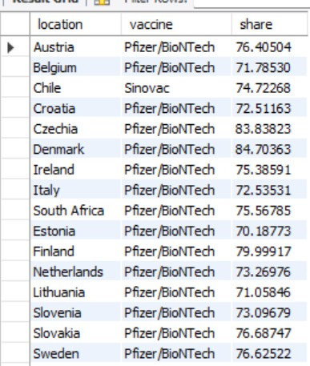
Q1: Countries where one vaccine contributed >70% of total vaccinations.

Slide 16
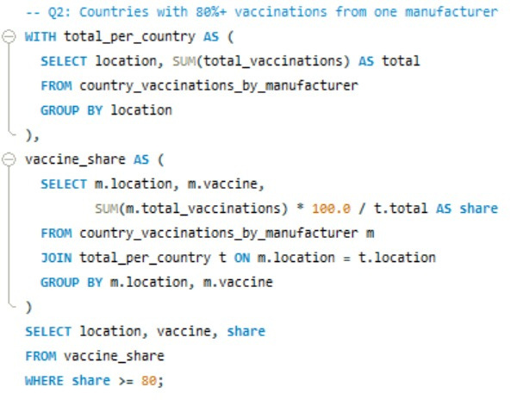
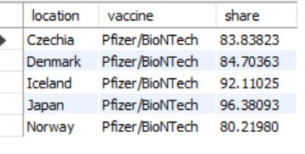
Q2: Top vaccine in first 60 days for each country.

Slide 17
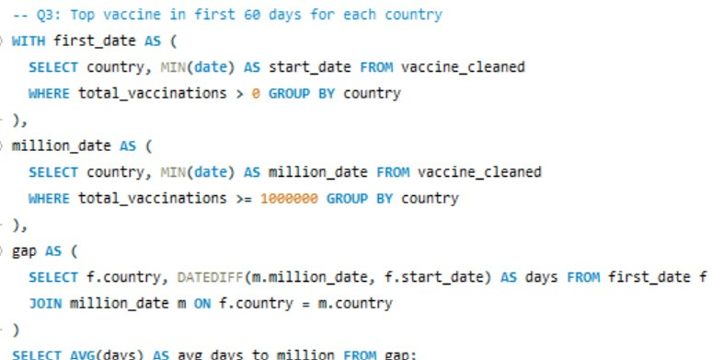

Q1: Countries with 80%+ vaccinations from one manufacturer

Slide 18
SUMMARY
I used SQL to analyze global COVID-19 vaccination data, focusing on country-wise trends and manufacturer usage. Key insights included top vaccinated countries, vaccine diversity, time to reach 1M doses, and dominant vaccines per country. The analysis highlighted rollout speed, strategy, and consistency using advanced SQL queries.

Slide 19

THANK YOU

